Slide 1
2013 EdTA Summit, Denver
CTE
What you need to know about
career and technical education
Jennifer Jirous, Colorado Community College System
Krista Carson Elhai, Claremont (California) High School
Cory Losenicky, Greenway High School, Phoenix, Arizona
James Palmarini, EdTA home office

Slide 2
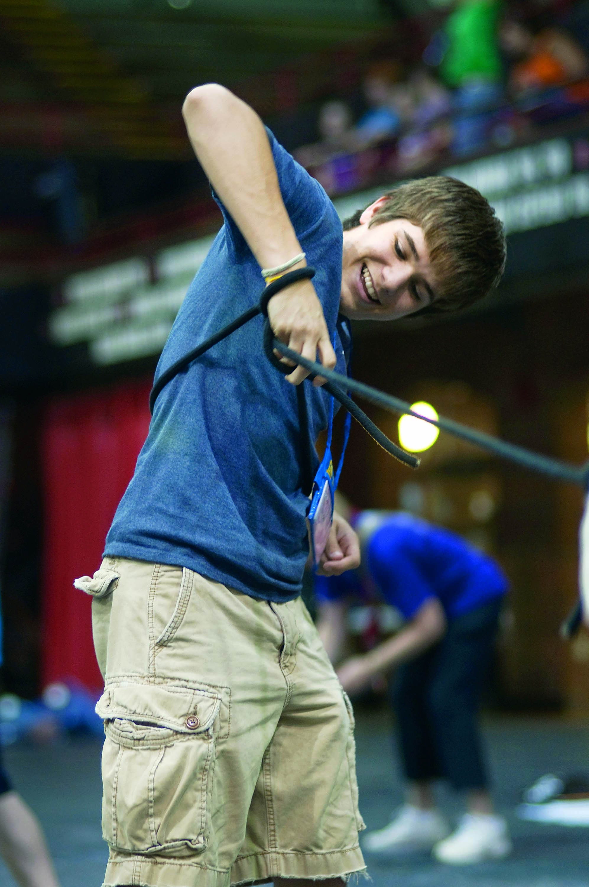
Theatre
is a
job

Slide 3
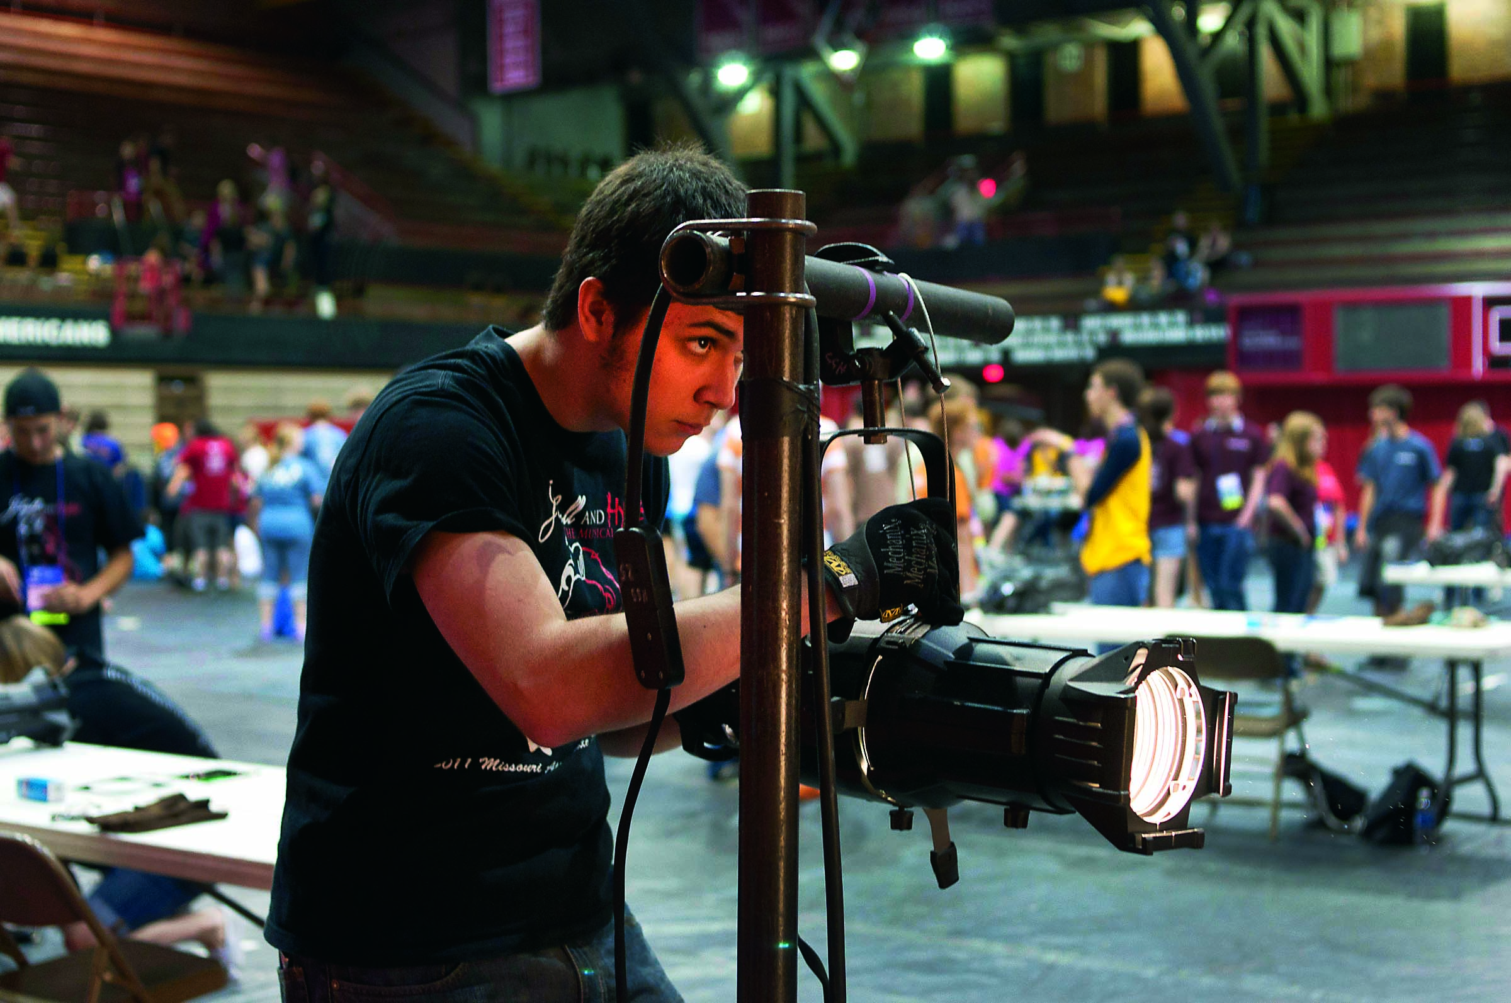
Theatre is a career

Slide 4
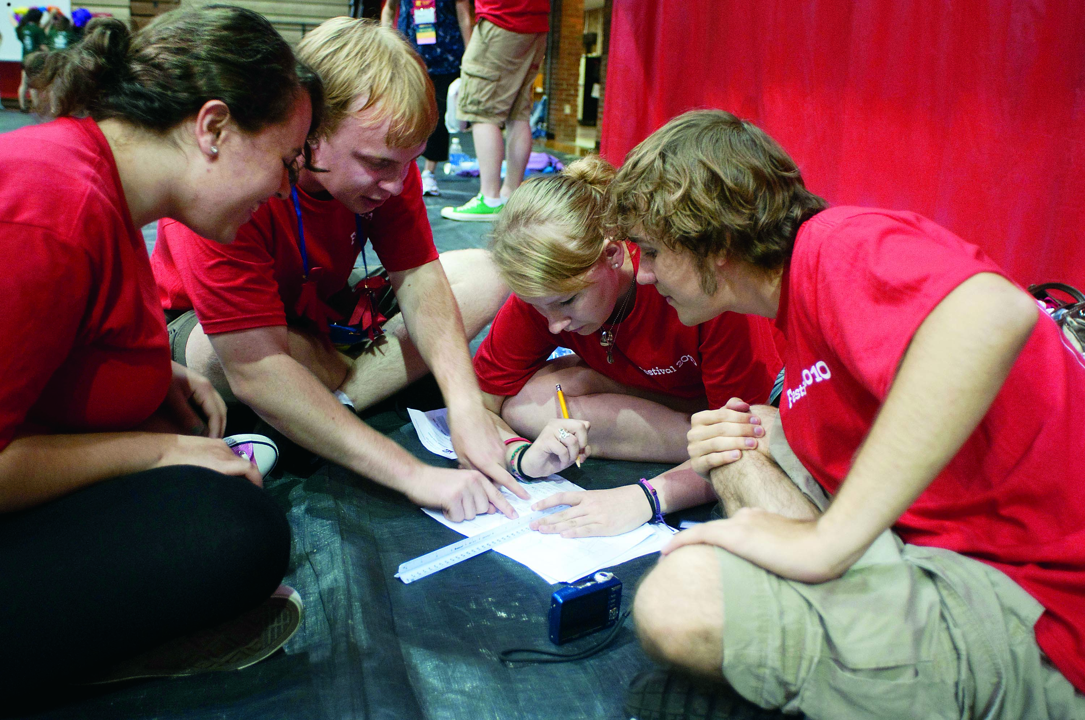
Theatre is
Career and technical
Education

Slide 5
EdTA and CTE
Four states identified where members are receiving CTE funding for their Thespians and theatre programs:
Arizona
California
Colorado
New Jersey

Slide 6
We wanted to know more
Four states where members are receiving CTE funding for their theatre programs:
Arizona
California
Colorado
New Jersey

Slide 7
A member survey
16% of all members responded.
56 respondents said they had received CTE money from their state and/or district.
94% used the funds for technical theatre classes or towards tools, infrastructure upgrades, or professional development.
27% received funding for their performance-based program classes.
43% used funds exclusively for in-school curricular classes; 55 % used it for in- and after-school theatre activities.
85% of all survey respondents who were not receiving CTE money said they were interested in applying for it in the future.

Slide 8
Welcome to Colorado

Slide 9
EDUCATION FOR THE 21ST CENTURY The Role and Value of Career and Technical Education in the Creative Pipeline
Jennifer Jirous
Colorado STEM, Arts, IT CTE Program Director
Colorado Community College System

Slide 10
Attendee Poll CTE Who are you? What’s your role? Where are you?
1
Not familiar at all
3
Somewhat familiar, wanting more specific pieces today.
5
Very familiar

Slide 11
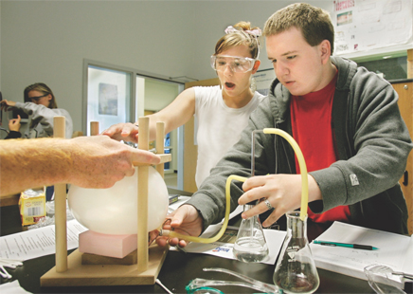
What Is Career & Technical Education (CTE)?
Evolved beyond “your parents’ vocational education”
Combines academic, technical, and “soft”/21st Century skills and learning
Taught in classes that combine relevance and rigor
Prepares learners for college and careers
Promotes partnerships among education, the workforce, business, industry, and the community
Delivers more options for success to more American students
Notes:
What is Career and Technical Education?
Our mission is to ensure a thriving Colorado economy by providing relevant and rigorous education that is connected, responsive and real.
Career and Technical Education is about helping students, workers, and lifelong learners of all ages fulfill their working potential. First and foremost, it is about high school and college education that provides students with:
* Academic subject matter taught with relevance to the real world, often called contextual learning
* Employability skills, from job-related skills to workplace ethics
* Education pathways that help students explore interests and careers in the process of progressing through school
What is unique and valuable about CTE?
It’s new: it includes academics and is responsive to the labor market.
It hasn’t done away with vocational education per se; rather, it encompasses vocational curriculum within something greater.
It’s not just classes at school, but a whole system of opportunity.
It offers concrete--not abstract--solutions to students, parents, and teachers.
As in many states, CTE in Colorado has been implemented according to the Carl D. Perkins IV Career and Technical Education Act of 2006, which greatly expands the flexibility and adaptability of schools and colleges to meet educational and workforce needs.
The purposes of the Perkins Act are to:
Develop challenging academic and technical standards and related challenging, integrated instruction.
Increase opportunities for individuals to keep America competitive.
Focus on high skill, high wage, high demand occupations.
Promote partnerships among education, workforce boards, business, industry, etc.
Provide technical assistance and professional development.
Emphasize preparation for postsecondary education and employment--preparation not in the sense of direct ‘job’ preparation but rather of academic and technical preparation
Increase emphasis on the achievement of a degree, certificate, or credential.
Perkins authorizes legislation through FY 2012.

Slide 12
Carl D. Perkins Career and Technical Education Improvement Act of 2006, Section 2:
Develop challenging academic and technical standards; assist students in meeting them; including preparation for high skill, high wage, or high demand occupations in current or emerging professions
Services and activities that integrate rigorous and challenging academic and CT instruction and link secondary and postsecondary for CTE students.
Increase State and local flexibility in providing services and activities designed to develop, implement, and improve CTE

Slide 13
Carl D. Perkins Career and Technical Education Improvement Act of 2006, Section 2:
Technical Assistance that
Promotes leadership, initial preparation and professional development at State and Local levels
Improves the quality of CTE teachers, faculty, administrators, and counselors
Provide individuals with opportunities throughout their lifetimes to develop, in conjunction with other programs, the knowledge and skills needed to keep the United States competitive.

Slide 14
The Creative Economy in Colorado
Over 186,000 jobs
5th highest concentration of artist in the U.S.
Creative enterprises employ over 122,000 individuals in 8,000 establishments.
Colorado ranks:
2nd in concentration of architects
7th in concentration of writers, designers, entertainers and performers
8th in concentration of photographers.
Colorado Creative Industries. (2008, December). Economic Development Colorado's Creative Economy Study. Retrieved November 17, 2010, from http://www.coloarts.state.co.us/programs/economic/co_creativeconomy/
Notes:
4:08 p.m.

Slide 15
REAL jobs in the Creative Economy
Public relations/ marketing managers
Architects/ Landscape architects
Curators
Advertising/ promotions managers
Radio operators/ Camera operators
Archivists
Editors
Film & video editors
Commercial and Industrial designers
Producers/Directors
Sound engineers
Museum technicians and conservators
Interior designers
Reporters/ correspondents
Fashion designers
Set & Exhibit designers
Graphic designers
Choreographers
Floral designers
Art directors
Photographers
Writers & Authors
Multi-media artists & animators
Actors
Musicians & singers
Fine Artists in all fields
Craft artists
Entertainers & performers
Agents & business managers
Dancers
Music directors & composers
Stagehands
Notes:
4:08 p.m.

Slide 16
Skills for a Creative Economy
Critical thinking and reasoning
Problem solving, Analysis, Logic, Cause/effect
Information literacy
Knowledge acquisition, Source discernment, Systems management
Collaboration
Synergy, Team resourcing, Social skills, Leadership
Self-direction
Adaptability, Initiative, Personal responsibility, Work ethics, Self-advocacy
Invention
Creativity, Innovation, Integration of ideas
Notes:
You can see that many of these skills are developed through both STEM and Arts Education. Yes, in order to effectively prepare students these skills must be taught as a collaborative system. Our traditional educational systems included teaching content in isolation. Effective 21st century systems but involve connections and collaborations of subject areas and teachers.
Some of these may have been mentioned in the 21st Century Education poll.

Slide 17
Why CTE? Not your Father’s Voc. Ed.
Our Vision
Colorado CTE delivers proven pathways
to lifelong career success!
Our Mission
CTE ensures a thriving Colorado economy by providing relevant and rigorous education that is connected, responsive and real.
Our Method
Integration of effort across clusters & between agencies

Slide 18
The Colorado CTE Landscape
CTE uniquely placed in the Community College System
Secondary and Post-secondary programs governed by common board
Colorado State Plan – integrated implementation of Perkins IV
Recognition that rigor follows relevance and not the other way round
CTE organization and staffing
Student Leadership Organizations
Education Preparation /Endorsement/Credential
Concurrent Enrollment
Career Clusters and Plans of Study

Slide 20
Seamless Transitions:
Elementary: Career Awareness
Middle:
Career Exploration
High: Career Concentration
Post Secondary: Career Preparation
Lifelong: Career Advancement and Management
Career Development Journey

Slide 21
Section IV – Integration/Alignment CTE Connects the Dots
Occupation/Skills defined by B&I
Standards/Alignment to Core knowledge
Extended Learning Opportunities
Plan of Study/ICAP
Demonstration/Measurement of skill attainment

Slide 22
Aligning Academic & Technical Content
2009 Senate Bill 0212- CAP4Kids
2(b): In developing the preschool through elementary and secondary education standards, the State Board shall also take into account any Career & Technical Education standards adopted by the State Board for Community Colleges and Occupational Education, created in Section 23-60-104, C.R.S., and, to the extent practicable, shall align the appropriate portions of the preschool through elementary and secondary Education standards with the Career and Technical standards.

Slide 23
Plans of Study - REAL Process
Intended as a primary guide as students create their Individual Career & Academic Plans (ICAP)
Assist student in designing a meaningful educational experience that is relevant to their individual career aspirations (ICAP)

Slide 24
What is it all really?
The ICAP, or Career & Academic Plan of Study is a process that students participate in, which results in an actual plan.
Process:
Developmentally appropriate recommended activities
Plan:
Student’s career cluster or pathway goal
Relevancy of student’s goal to post secondary institution / workforce or other future option
Student’s intentional courses sequence & relevant experience
Utilizing:
CTE, core curricula, existing & available resources (CDE, CDHE & CCCS), career & academic planning tools & assessments and “the village”.
Notes:
Right now a PS POS is in the developing stages – we support the concept and belief in it.

Slide 25
Policy Matters
Colorado Paradox
Colorado Promise
P-20 Council – PWR/Concurrent Enrollment
Creative Industries Legislation (2010)
Arts Education Workforce Development (2010)
Creative Districts (2011)
Colorado “Blueprint for Economic Development”

Slide 26
Section VI - Real Partnerships
Seamless Education
Standards Revisions & Alignment
Seamless Pathways through Articulation Agreements
Comprehensive Guidance
Business, Industry, Colorado Department of Labor & Employment, Economic Development, etc.

Slide 27
Education Partners
Colorado Department of Education
Career Fairs & Career Academies
Visual and Performing Arts Specialist
Colorado Department of Higher Education
Educator Preparation Standards
College In Colorado
C-Acronymns – Art/Music/Theatre/Dance Educators
Co-Curricular Partners – Think 360, SCFD
Colorado Association of Career and Technical Educators

Slide 28
Business Partners
CTE Advisory Committees
Trades Partners
Colorado Succeeds www.coloradosucceeds.org
Chambers of Commerce
Economic Development
Employers

Slide 29
Successes
Creative Careers Student Leadership Organization
Connections with Thespians
Credentialing/Endorsement
New Colorado Association of Career and Technical Educators (CACTE) Division
Creative Careers Festival

Slide 30
Career & Technical Education Creative Careers Festival Friday 19 April 2013

Slide 31
Section VII: Next Steps
How do I take this forward?
Creative Education is not done in isolation, I need to help build that “Village”, make conversation with the “Village” members.
Where do we start?
Conduct an inventory of what you are already doing with the Arts. Include arts education and creative economy research if possible.
Where do I go from here?
Consider the Individuals, the partnerships, the existing tools that can be utilized (e.g. CTE, CiC, EPAS , Business & Industry, AVS, Counselors and more!)
How can I do these kinds of things in my world?
Consider strategically implementing ICAP, Career Guidance and CTE to support Creative Education needs.

Slide 32
Resource Website: www.coloradostateplan.com

Slide 33
Thank you!
Jennifer Jirous, Colorado CTE STEM, Arts, IT Program Director
Colorado Community College System
Jennifer.jirous@cccs.edu

