Slide 1
Beginnings of Performance
3/27/18

Slide 2
“Og the Great"
Og was the great caveman who decided to tell others of the events that took place during a hunt by mime. Without language Og was forced initially to mimic or recreate the events in order to communicate what took place. While Og is clearly not a specific character we know that this likely took place all over the world and is in effect the first theatrical performance.

Slide 3
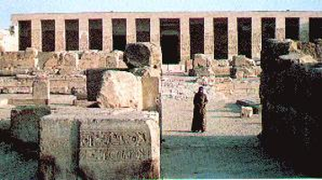
Ancient Egypt
2,500 BC at Abydos: the so-called “Abydos Passion Play” The oldest existing script from a theatrical presentation.
A religious drama about the death and rebirth of Osiris

Slide 4
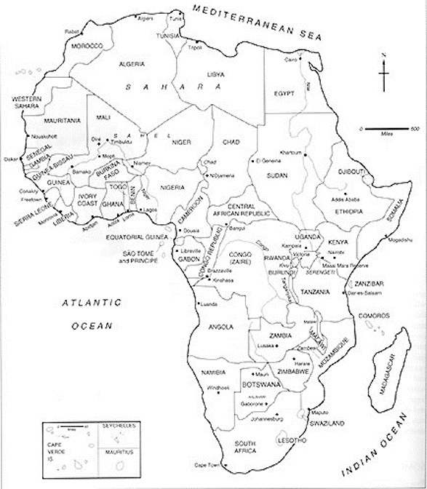
Traditional African Theatre

Slide 5
Traditional African Societies
Theatre in the Western sense does not exist in traditional African societies
Aspects of Traditional African Theatre Include:
Festivals, celebrations, seasons as context
Fusion of dance, drama, song, narrative
Often cultic and religious purposes
Fluidity of performance space, less separation of performers and audience, less distinction between reality and fiction
Improvisation, openness of performance

Slide 6
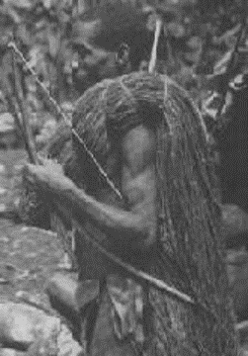
“Paratheatrical” performances
Zulu wedding ceremony
Complex system of symbolic dances expressing adversity, resolution
Elephant hunt dance of the Mbuti pygmies (Zaire)
Dance mimetically imitates the destruction the beast can cause

Slide 7
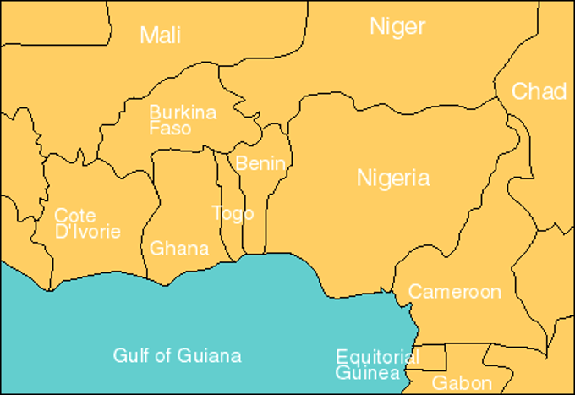
West Africa

Slide 8
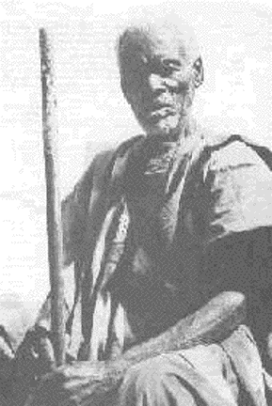
Griots
West African storytellers and oral historians (“Praise-singer”)
Highly respected, often sanctified members of the community, advisers to kings or chiefs
Charged with retaining and reciting genealogy and history of the tribe

Slide 9
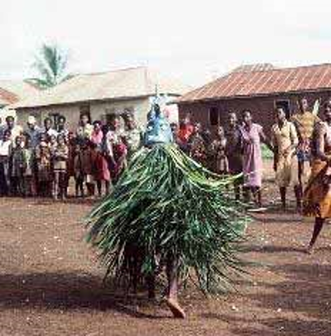
Masquerades
Mask serves to hide human face, invoke the “Other”
Mask mediates between human and spirit world
States of trance often obtained while wearing the mask

Slide 10
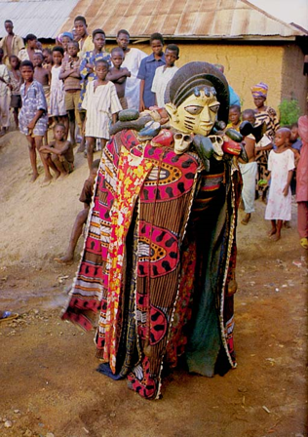
Egungun
Annual Yoruba ancestor-worship and purification masquerade
Translates to “concealed powers”
Dancers completely concealed
Mask/costume “transforms” in violent dance moves, revealing inner layers
Dance invokes blessings of ancestors

Slide 11
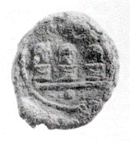
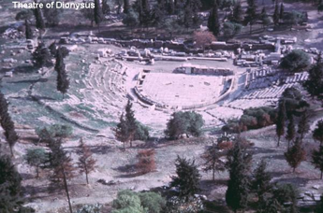
Ancient Greece
At the City Dionysia, three playwrights presented three tragedies each
550 BCE

Slide 12
China
China has a long history of Theatre including theatre based play and games called “xi” [shee]
Long performance tradition
Han Dynasty (206 BCE- 221 CE) had “Hundred Plays”
Tomb painting in Hunan province, 200 CE

Slide 13
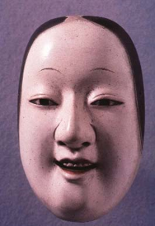
Japan Uzume’s Dance
Sun goddess Amaterasu (from which Japanese emperor claims descent) went into hiding in a cave after an argument with her brother A young goddess, Uzume, performed a comic dance that lured the sun goddess out fo hiding. Japanese performers still call themselves ”followers of Uzume”

Slide 14
Indian Theatre Creation Myth
Indra, the warrior god, asked Brahma, the Creator, to invent a form of amusement for all people so that they would be distracted from their baser pursuits
At the first performance, demons, Rakshasas, tried to disrupt the play, but Brahma built a roof over the stage to ward off the attacks

Slide 15
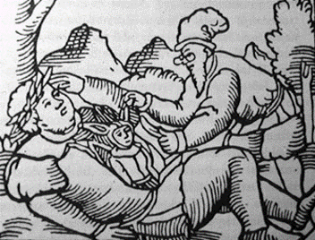
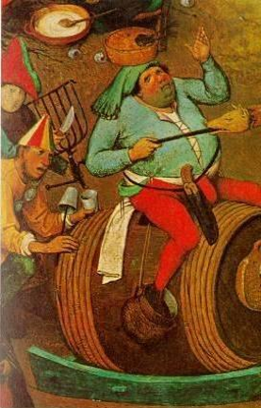
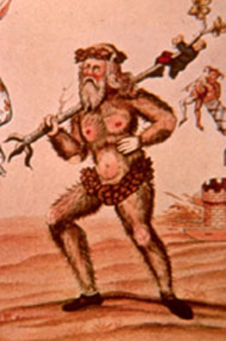
Germanic and European origins Carnival
Seasonal festival around February before 40 days of Lent
Pagan roots in Roman Saturnalia
Carne vale=farewell to the flesh
A festival of license, excess, inversion, disguise
Carnival as a total performance, but also separate carnival plays
Function of “safety valve” to maintain social order

Slide 16
Theatre, Myth, and Ritual
Ritual is a circumscribed and repeated activity (“twice done”) that often has aspects of performance
Rituals have to do with pleasure (sports, food), power (handshake, coronation), or duty (sacrifice, work)
Rituals tend to be about the managing of (dangerous) transitions
Rituals are “efficacious”

Slide 17
Theatre and Games
1. Special ordering of time -Event time, set time, symbolic time
2. Special value attached to objects -Balls, rings, ruby slippers
3. Non-productivity in terms of goods -No economic value
4. Rules -Game rules or theatrical conventions
5. A special ordering of space -Symbolic or liminal space

Slide 18
Sources and References
http://www.theatrehistory.com/origins/egypt001.html
https://www.pbs.org/empires/thegreeks/background/24a_p1.html
http://www.historyworld.net/wrldhis/PlainTextHistories.asp?ParagraphID=cui

