Slide 1
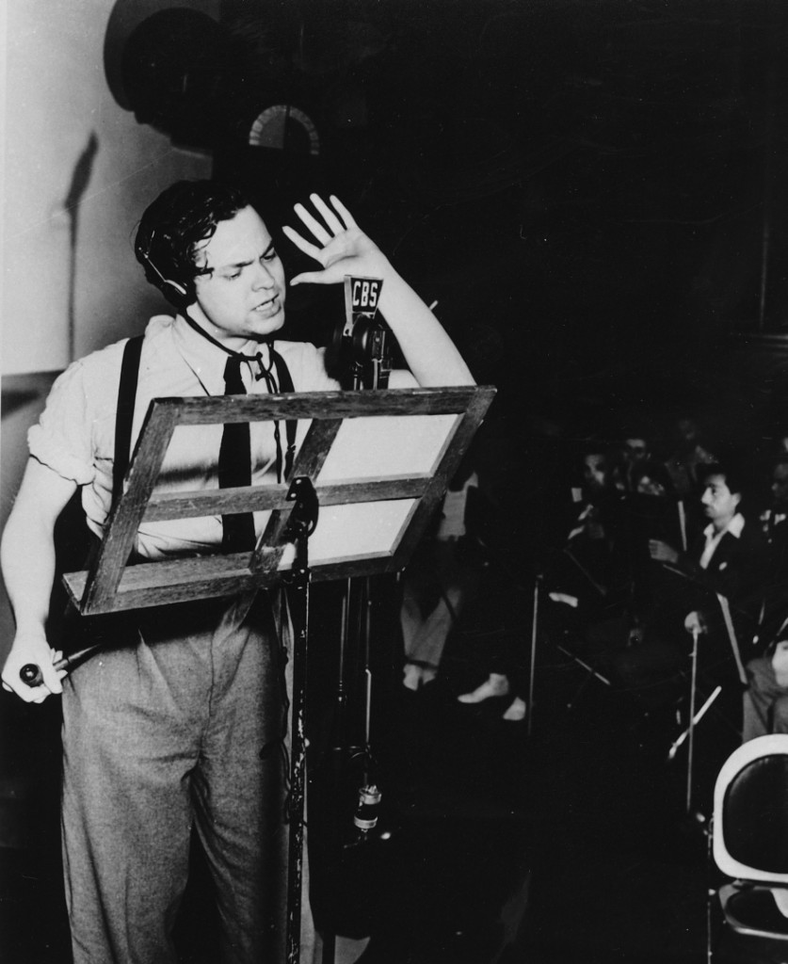
Orson Welles All-too-human Genius
b. 1915 d. 1985

Slide 2
Orson Welles All-too-human Genius
b. 1915 d. 1985
Was 23 years old when he produced WotW.

Slide 3
Orson Welles All-too-human Genius
b. 1915 d. 1985
Was 23 years old when he produced WotW.
No relation to H.G. Wells the author of the book, although the two did meet in 1940 on KTSA radio in San Antonio. Search “Orson Wells Meets HG Wells” on
YT if you’d like to hear it.

Slide 4
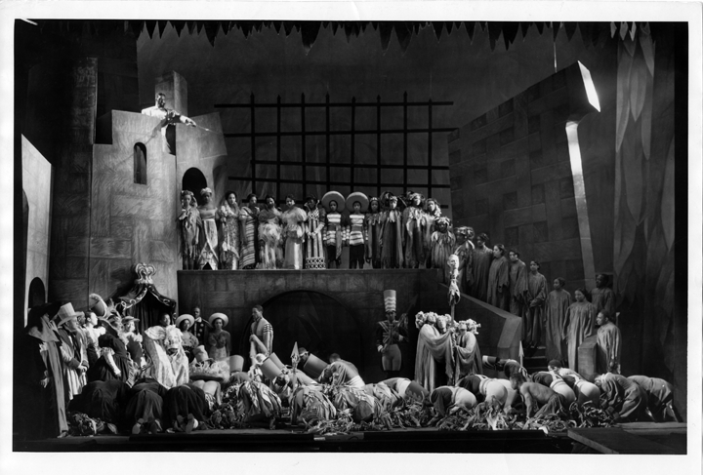
Orson Welles
At the age of 20, as part of the “Federal Theater Project,” he directed a cast of mostly inexperienced African-American actors in Harlem (The “Negro Theater Unit”) in a version of Macbeth set in Haiti. “Voodoo Macbeth” as it came to be known, was a smash hit.

Slide 5
Orson Welles
He had never directed anything outside of school productions before “Macbeth.”

Slide 6
Orson Welles
Welles was one of the most in-demand voices in all of radio. He used the money he made from radio to fund his theater projects.
He had so many gigs, he developed a rather novel way to get from studio to studio in NYC.

Slide 7
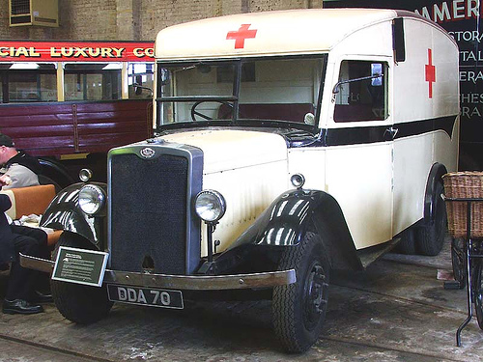
Orson Welles
He claimed that at the time, there was no law in NYC saying you had to be sick to travel in an ambulance.
So he hired one, to take him from gig to gig, lights flashing and sirens blaring.

Slide 8
Orson Welles
New York soon changed the law.

Slide 9
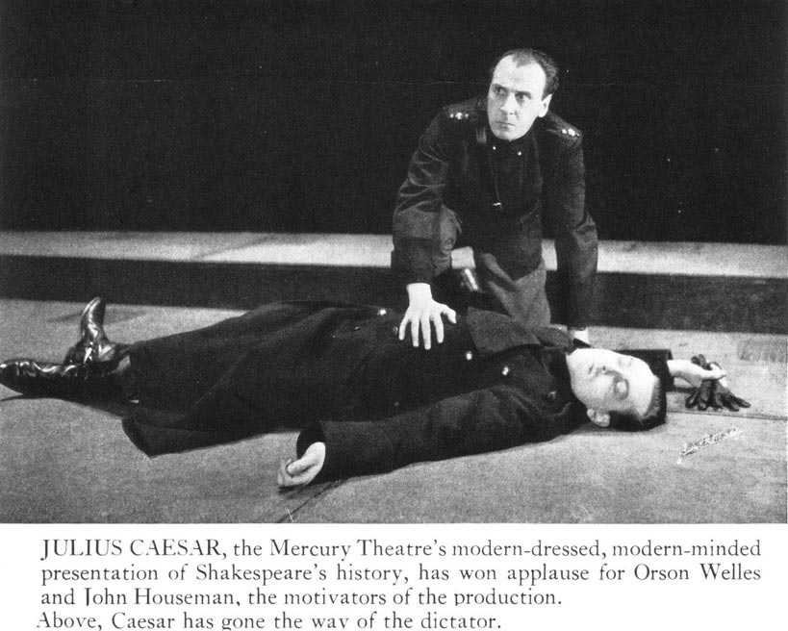
Orson Welles
In 1937, having left the Federal Theatre Project, Welles formed
“The Mercury Theatre.” His first production: Julius Caesar.
It was staged very starkly, and was obviously a slap at the rise of Nazi Germany.
Preview night: a disaster.
Opening night: standing ovation

Slide 10
Orson Welles
A year later, Welles was given a radio show.
“The Mercury Theatre on the Air” was born.

Slide 11
Orson Welles
It ran for 22 weeks unsponsored, and was then picked up by
Campbell’s, the soup people.
It continued as “The Campbell Playhouse” from December of 1938 to March of 1940.

Slide 12
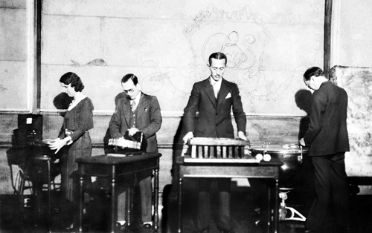
Sound Engineer Ora Daigle Nichols-a pioneer
Ora did the SFX for WotW. Here she is on the set of “The March of Time.” She did extensive work on the sci-fi “Buck Rogers.”
In the ‘30s, sound engineer was almost exclusively a male domain. Ora Nichols did the SFX for WotW. She was the head of the CBS Sound Department in the ‘30s. She was pretty much the only woman in the field.

Slide 13
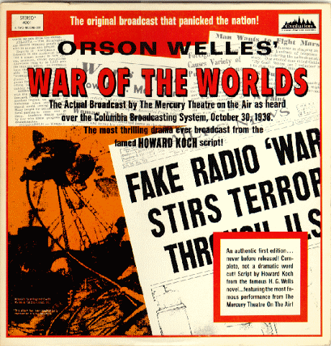
War of the Worlds
The 17th production of
“The Mercury Theatre on the Air”
Sunday, October 30, 1938

Slide 14
Orson Welles
War of the Worlds
panicked the nation. Folks thought it was real.

Slide 15
Orson Welles
It has been suggested that Welles timed his “breaking news” bulletins to coincide with the first music break in the immensely popular Charlie McCarthy show that was running at the same time. Folks who were changing stations landed on the “invasion.”

Slide 16
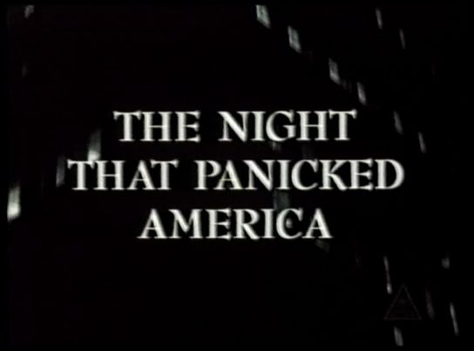
Orson Welles
This 1975 made-for-TV movie is a very good look at the hysteria. Sadly, it has never been released on any form of home video. It is on YouTube

Slide 17
Orson Welles
Seriously?
My late grandmother, who was alive at the time and heard the original broadcast, used to tell me that you really had to be pretty clueless to have fallen for it. There were multiple breaks and disclaimers. Newspapers hyped up the panic, because they wanted to make radio look irresponsible. Modern studies put the actual number of folks who believed it at around 1 million. Today, you can not broadcast simulated news.

Slide 18
Orson Welles
After WotW, Welles landed one of the most lucrative Hollywood production deals in history, giving him unprecedented control.
It resulted in arguably the finest American film ever made.

Slide 19
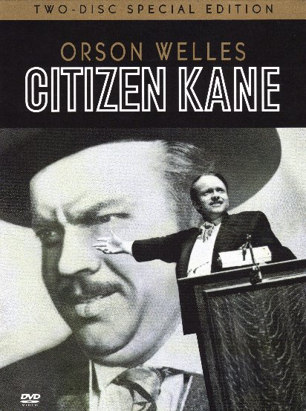

Slide 20
He was 25 years old.

Slide 21
He was 25 years old.
He would never again match the success of Kane.

Slide 22
See this film.
Your education is incomplete
if you
haven’t.

Slide 23
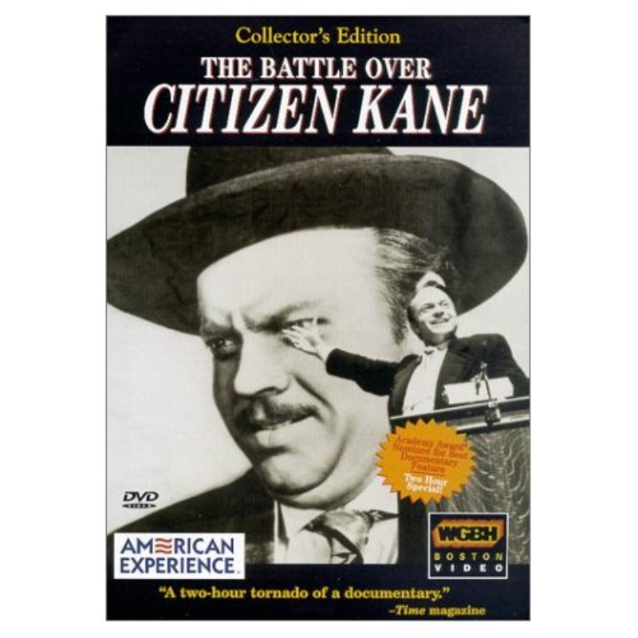
Multiple sources to thank, including:
Mercurytheatre.info
IMDB.com
Wiki
groversmill.wordpress.com
www.war-ofthe-worlds.co.uk
nationalgeographic.com
And notably:
Great documentary-on DVD, Blu-ray, and YouTube.

Slide 24
Today’s Trivia
Subject: Welles’ Final Film
The final film Orson Welles contributed to was a 1986 animated film. He recorded his part in 1985. These characters are still around today, and in fact have been recently featured in a very popular series of live-action blockbusters. Which characters?

Slide 25
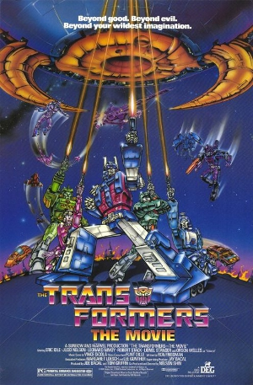
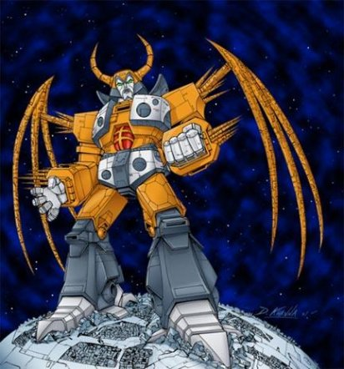
Today’s Trivia
Subject: Welles’ Final Film
He voiced “Unicron,” a near
planet-sized Transformer. Welles died mere days after recording the track.
1986

Slide 26
Let’s talk about a radio show…

Slide 27
Title: Zombie Storm (yes, the Zombie Apocalypse strikes PCA)
Goal: 15 minutes, including 2 60-second commercial breaks, intros, outros, etc.
Sound effects will be LIVE (not recordings). Vegetables sound delightful when attacked!
No ending necessary. Let’s do a classic cliffhanger.

Slide 28
Gonna need:
Writer(s)
Announcer
Director
Commercial crew
Sound effects crew (3-4)
Cast
I will serve as recording engineer.

Slide 29
We will work on this Friday, Monday, Tuesday, and half of Thursday. We record Thursday.
There will be an overall project grade that everyone gets, based on how well the show comes off. You can get more points for going above and beyond, or fewer if you don’t do your fair share.
We’ll do peer evaluations at end.

