Slide 1
Technology in the Theatre Classroom

Slide 2
Classroom Management vs. Technical Theatre

Slide 3
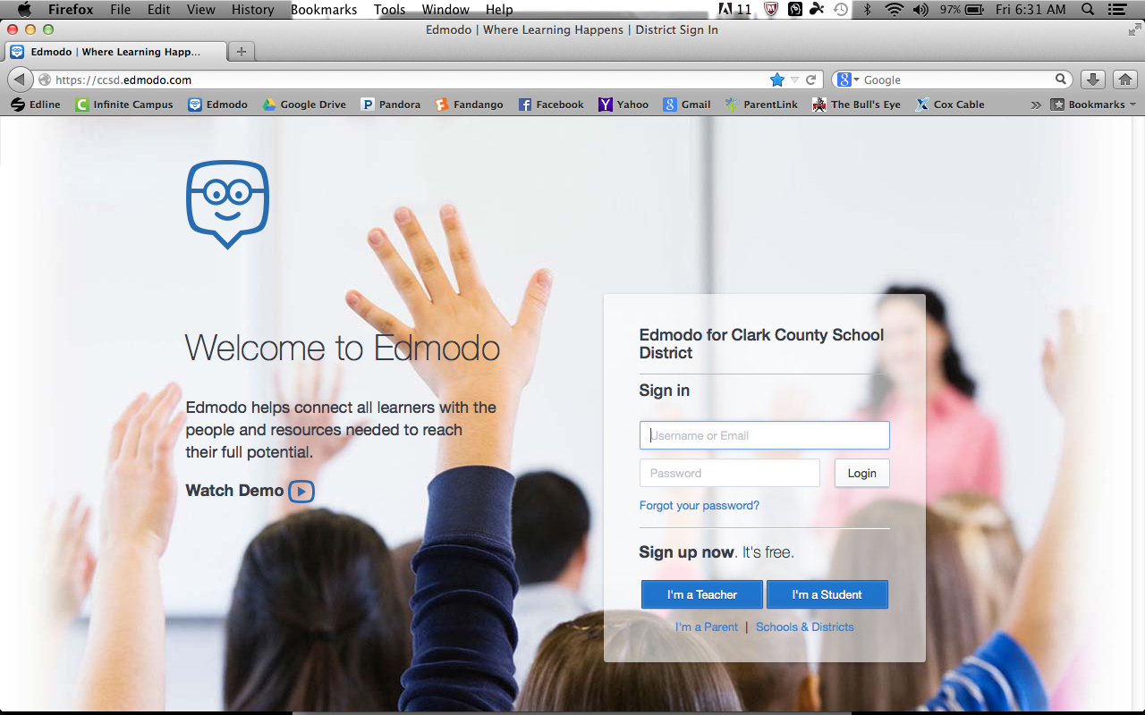
Classroom Management
Edmodo – ccsd.edmodo.com

Slide 4
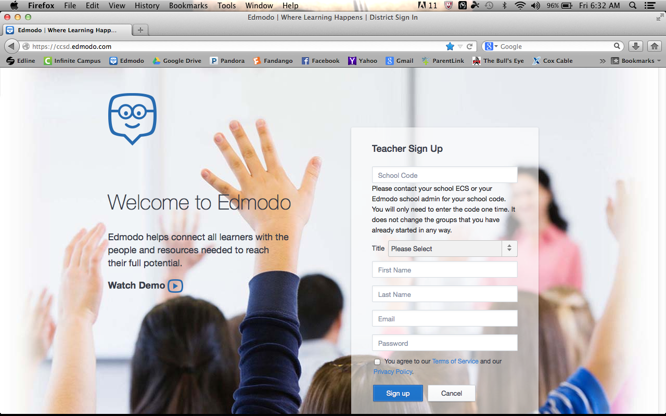
Sign up is free

Slide 5
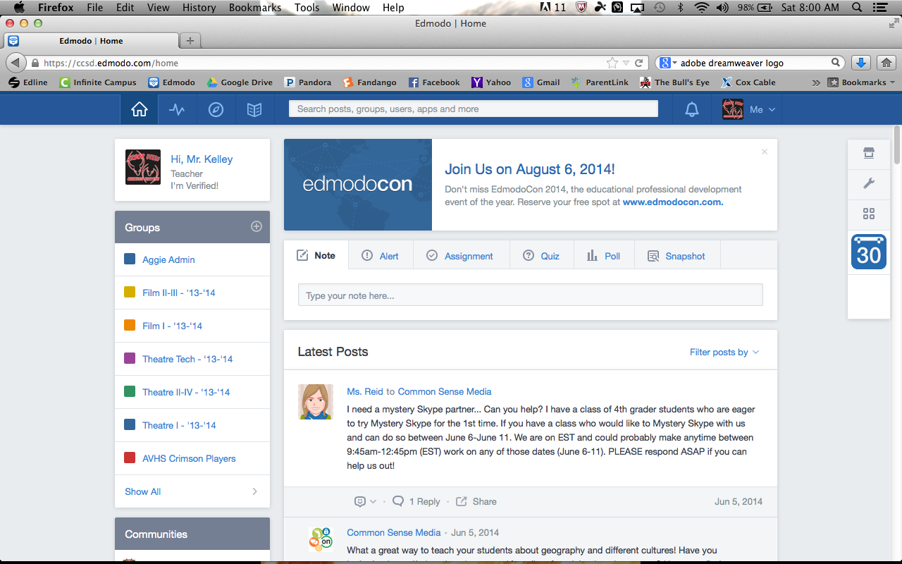
Groups
Each class gets a separate group.
Each group gets a code.
Groups can be used to create assignments for that class, uploading files for students, and messaging students.

Slide 6
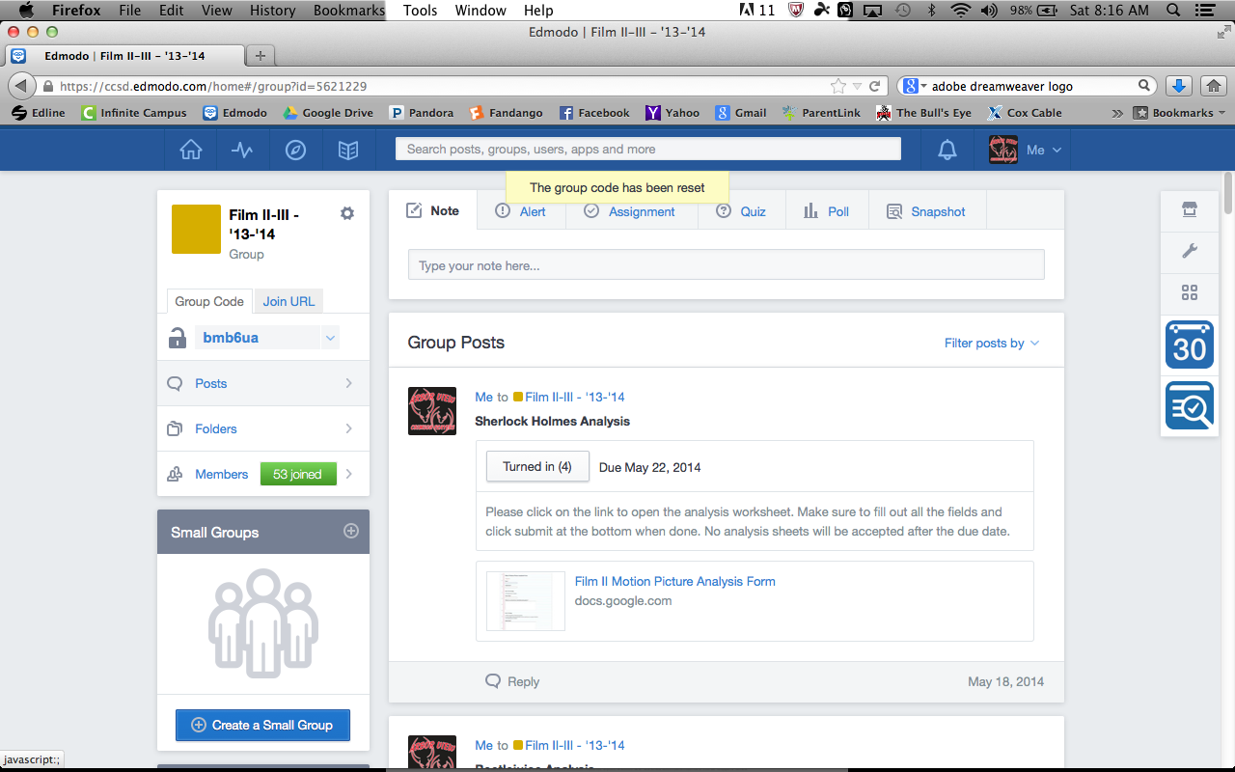
Group Code

Slide 7
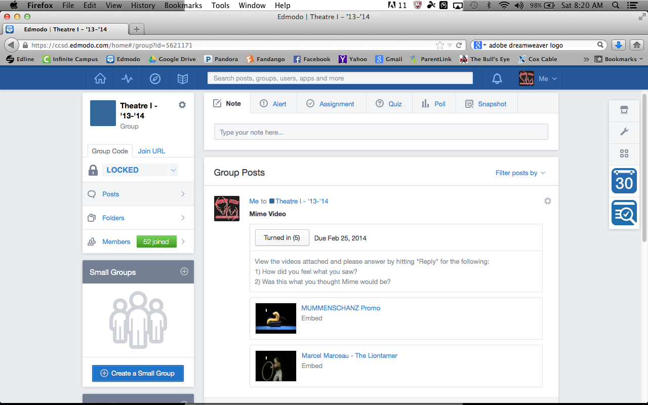
Assignments

Slide 8
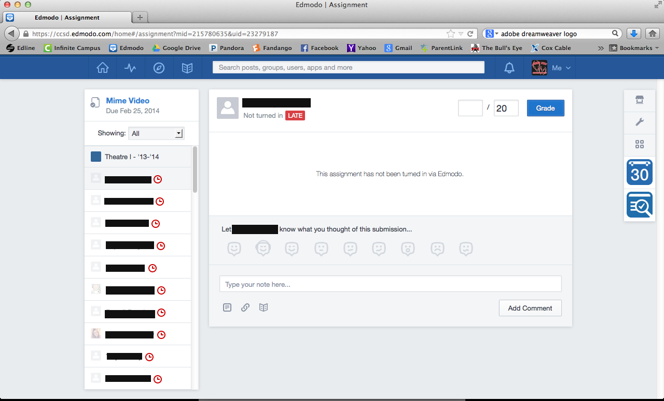
Grading on Edmodo

Slide 9
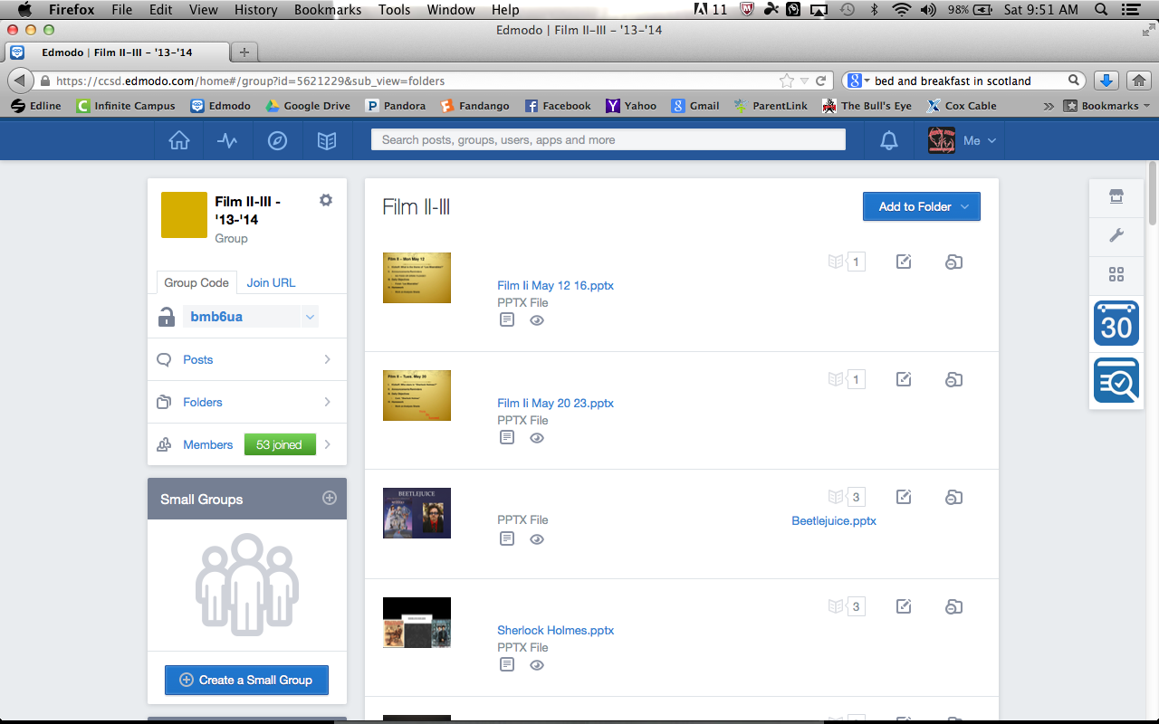
Uploading files for students

Slide 10
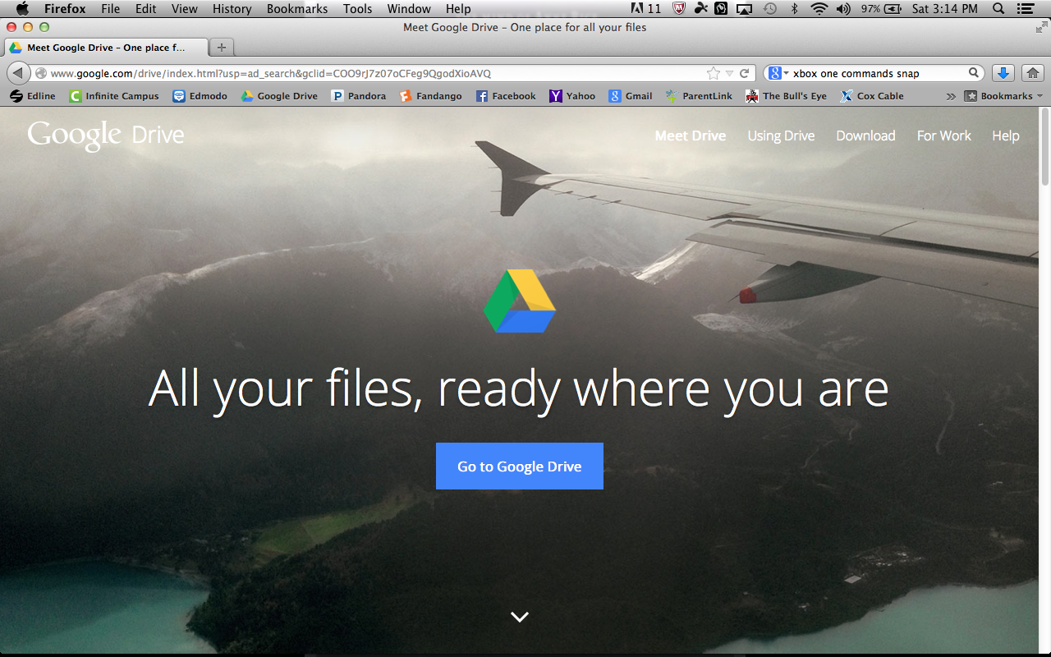
Google Docs/Forms
drive.google.com
Create online worksheets for students to submit.
Collaborate with students on written assignments.
Google Voice for phone communication

Slide 11
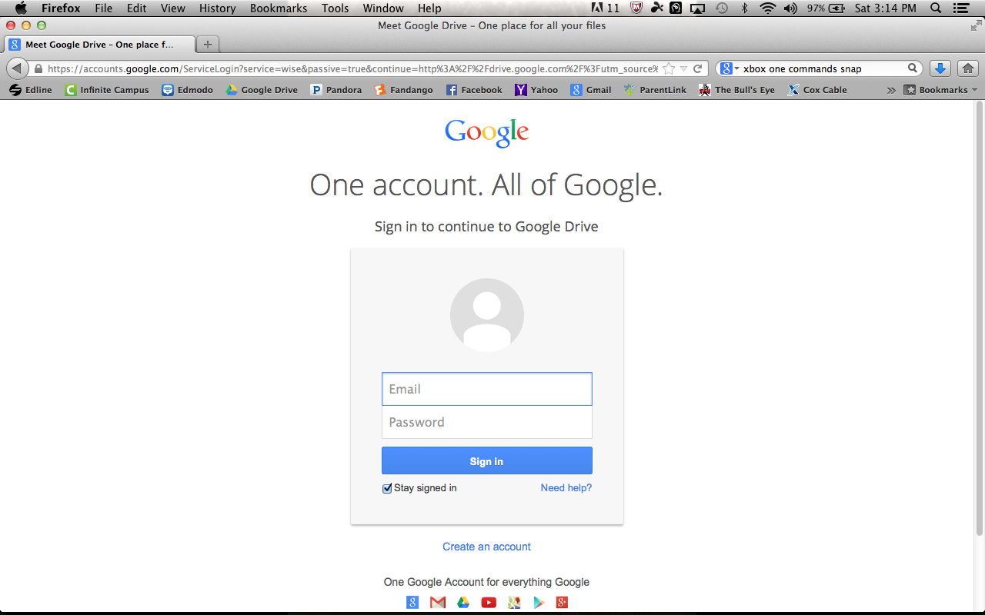
Use your free Gmail account

Slide 12
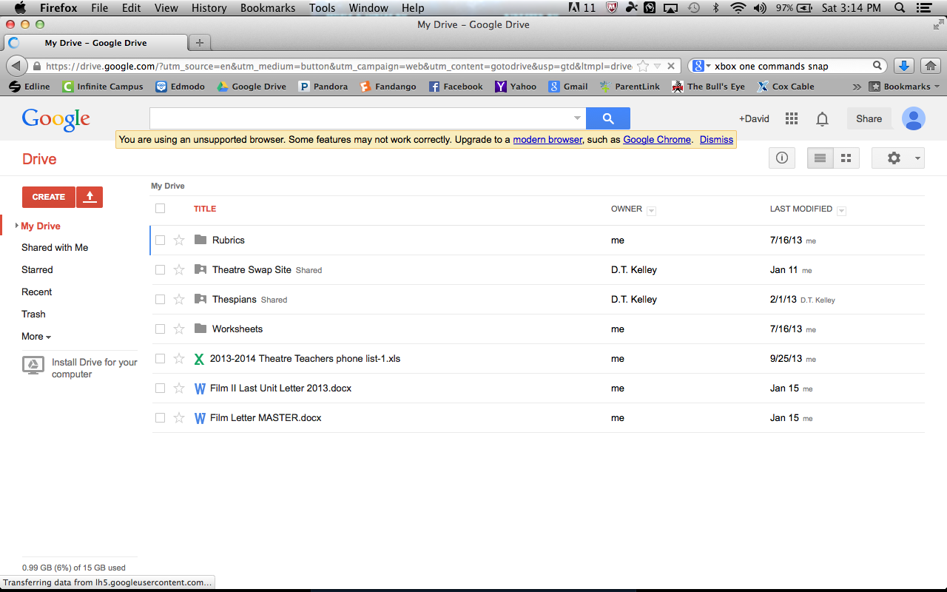
Create Forms

Slide 13
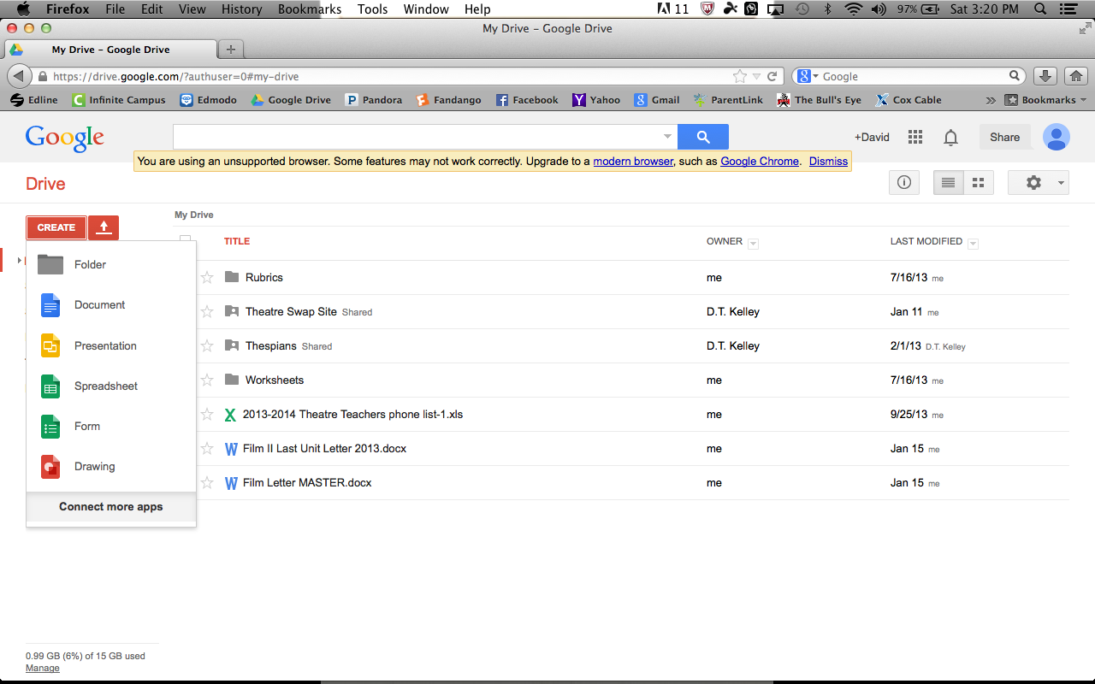
Select the type of doc to create (Form)

Slide 14
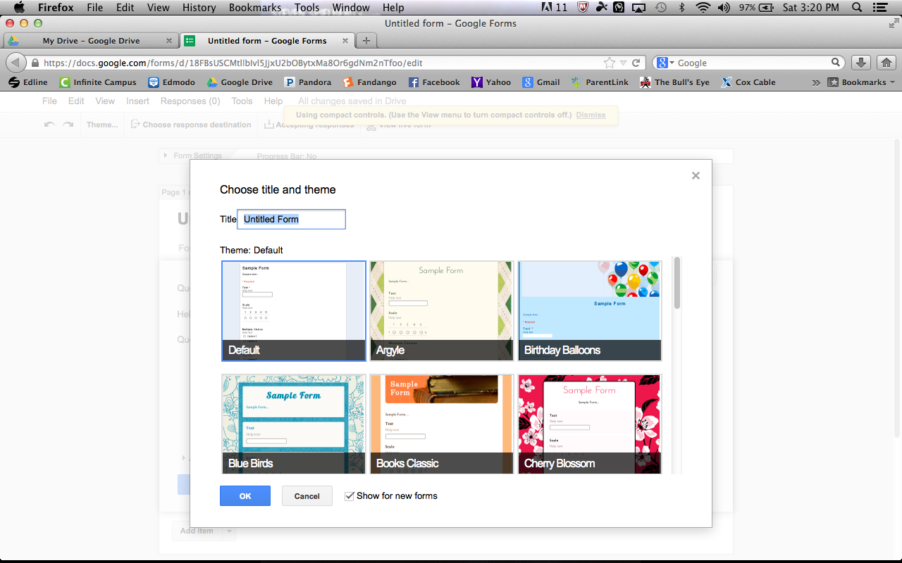
Select the style you wish to create

Slide 15
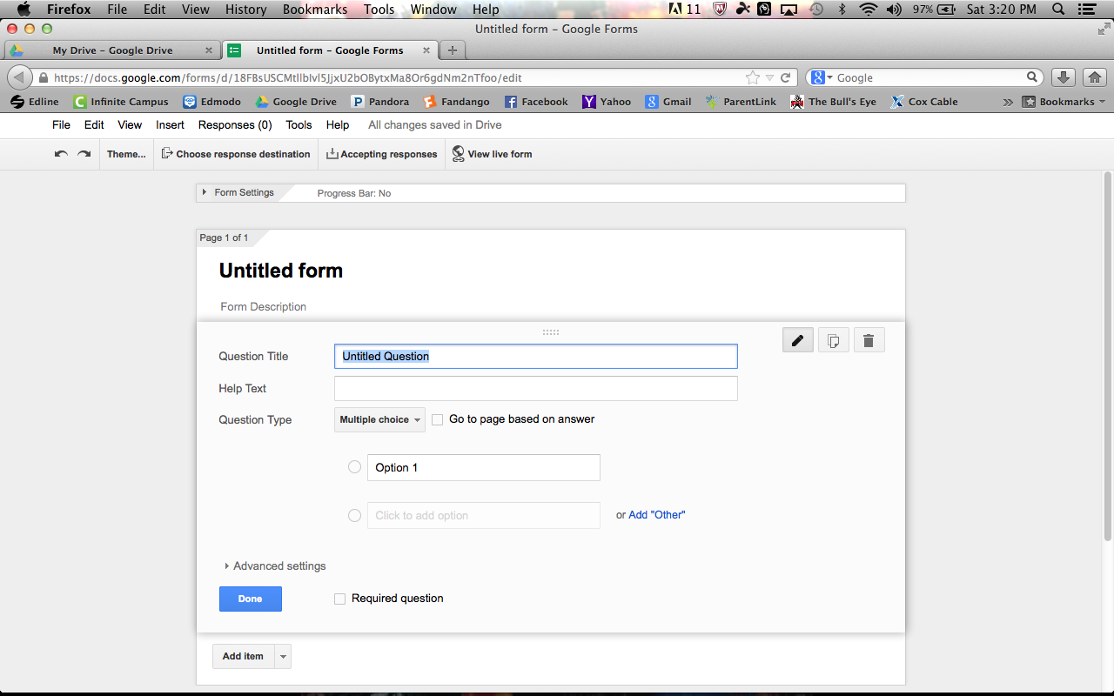
Begin to add your questions
You can add any type of questions you wish.
Multiple Choice
Short Answer
Choose from a list
You can add as many as you wish.
When completed click “Done.”

Slide 16
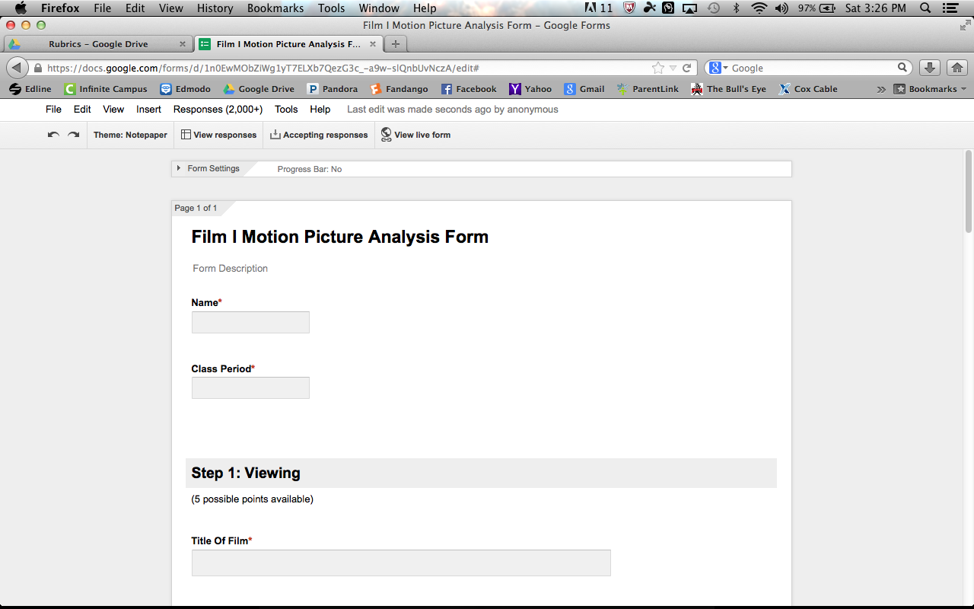
Your form is created – View it live

Slide 17
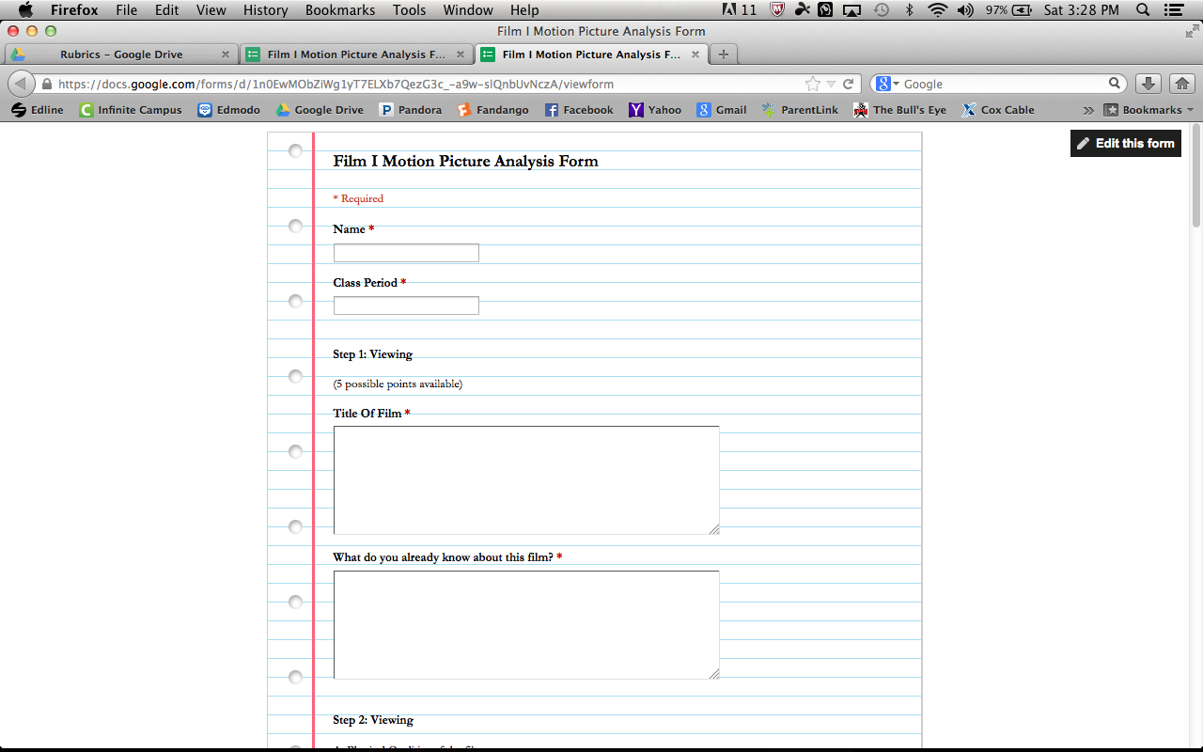
Students view – Share the URL with them

Slide 18
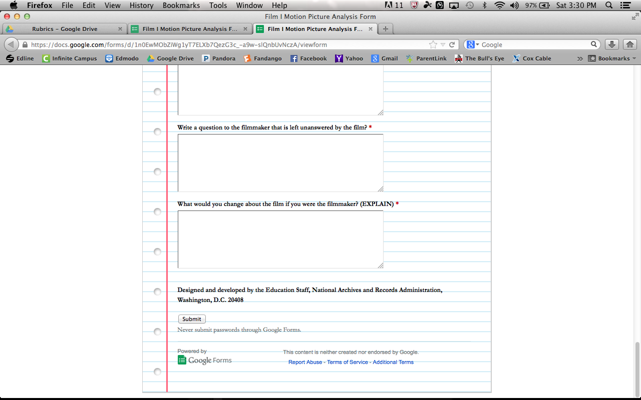
Students must click “Submit” when done

Slide 19
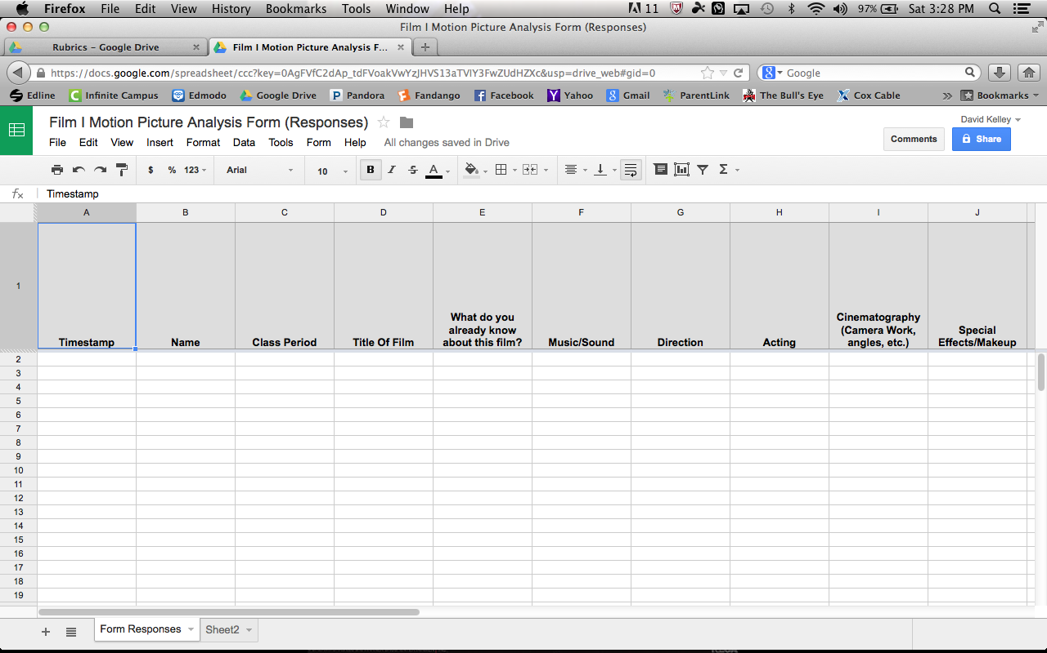
Students responses sent to Excel file

Slide 20
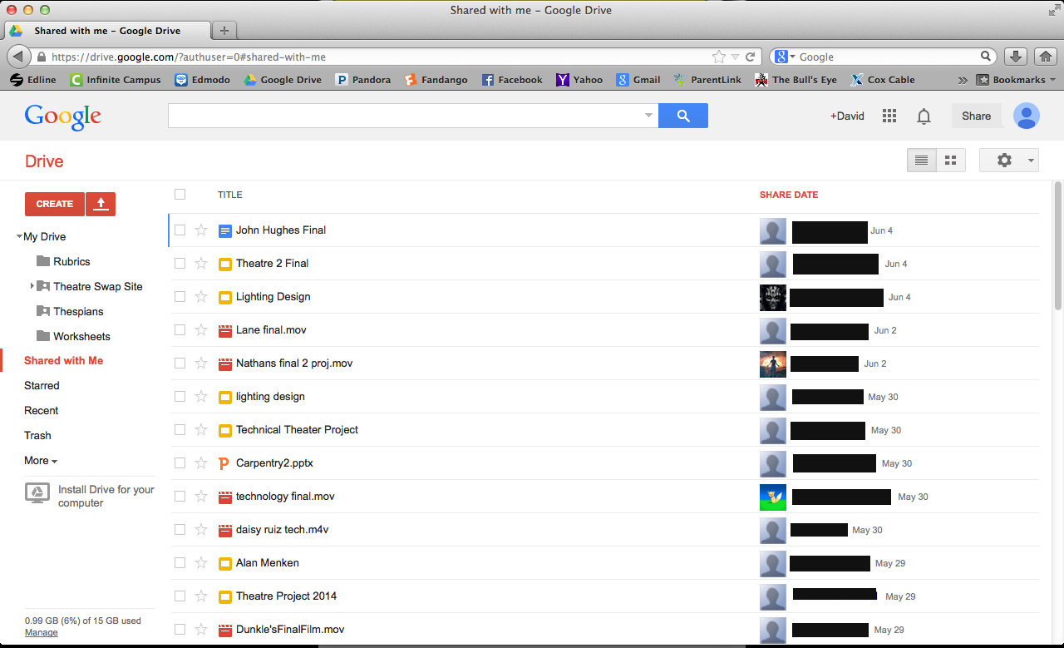
Google Share

Slide 21
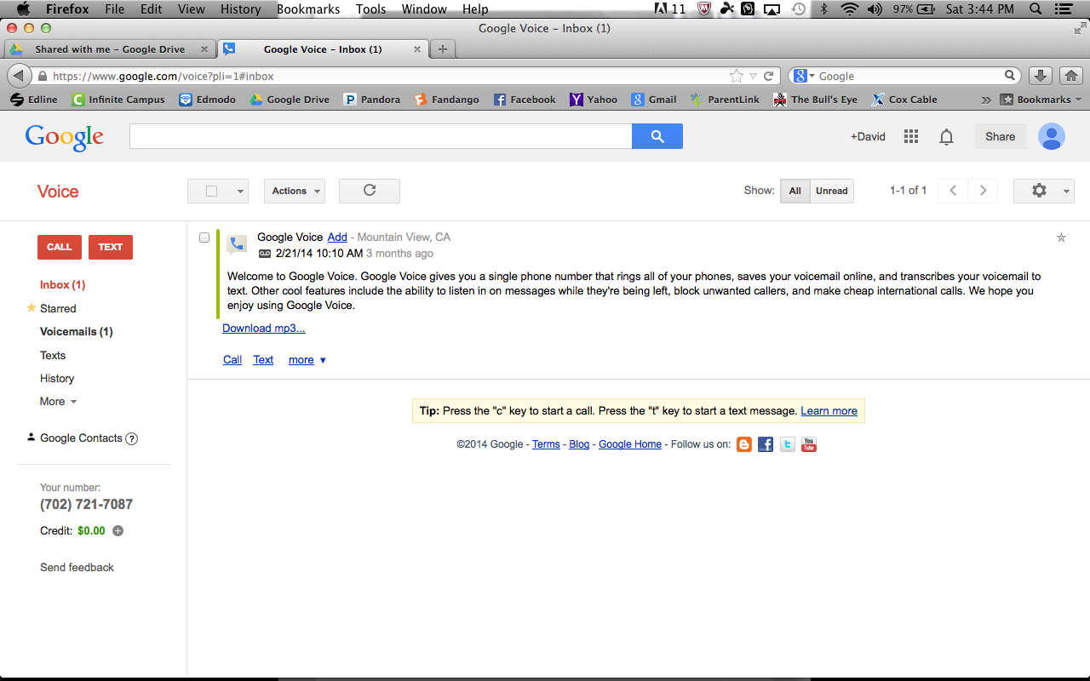
Google Voice

Slide 22
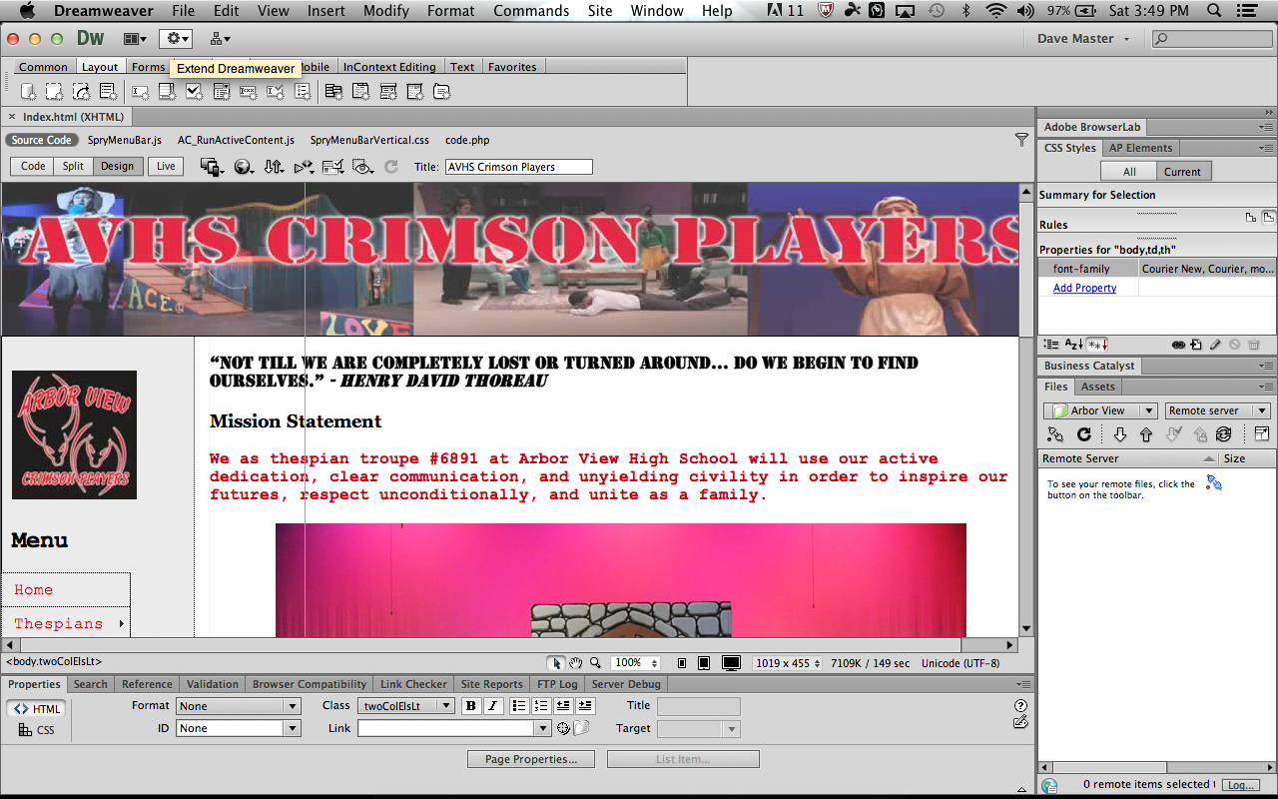
Adobe Dreamweaver

Slide 23
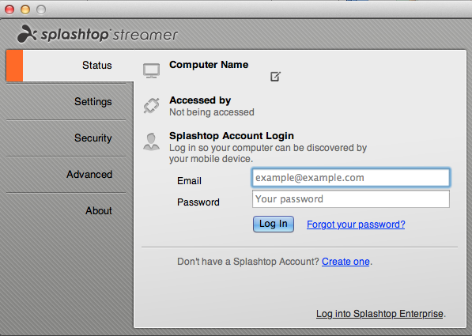
Splashtop Streamer

Slide 24
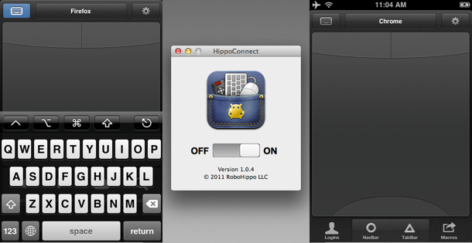
Hippoconnect
A laptop remote on your smartphone

Slide 25
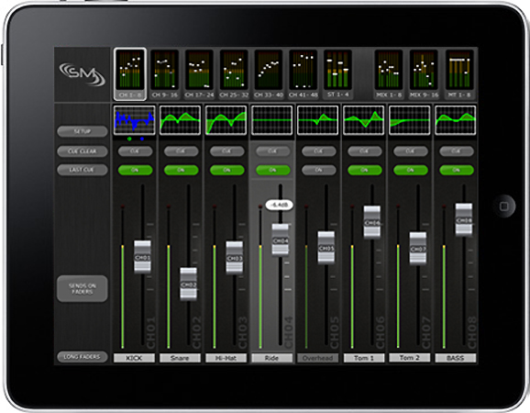
Technical Theatre
Yamaha LS9-32 Stagemix App for iPad

Slide 26
ETC Ion – iRFR and iRFR Preview apps
Select channels and set parameter data
Playback and edit cues
Park channels
Conduct dimmer and channel checks
Patch conventional fixtures
Manipulate color
View a Cue List Display (monitor only), with current cue, several previous and pending cues displayed
View and interact with a Playback display; controls include Go, Stop/Back and Go to Cue
Create a Console Connect List, making it easy to quickly connect to different control devices

Slide 27
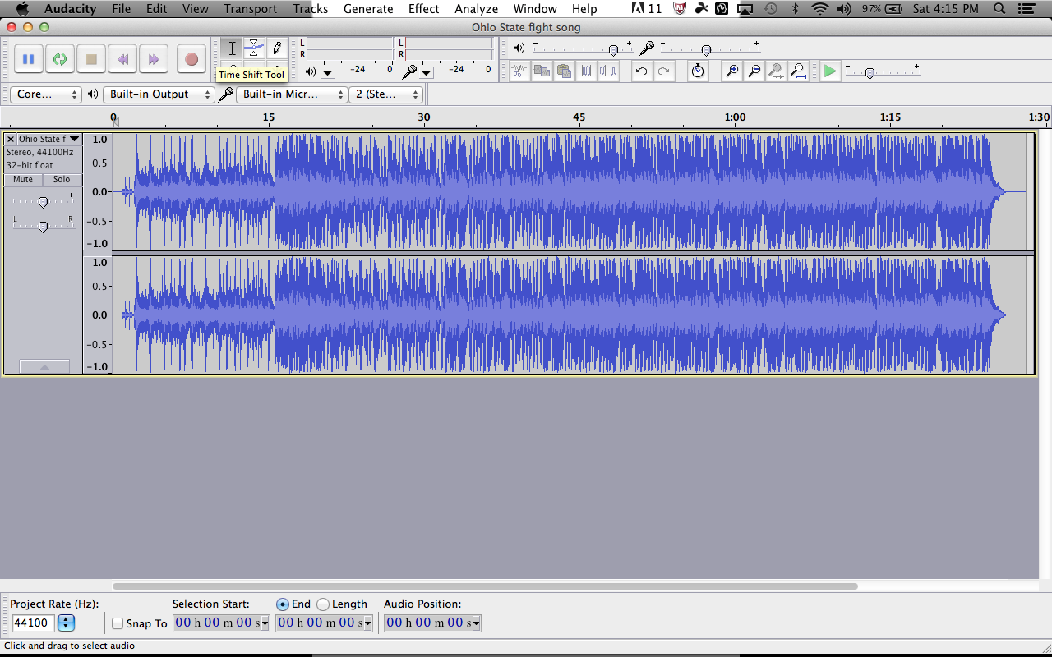
Audacity

Slide 28
Additional resources
Virtual Stage Manager – www.stagemanagement.com
Showtix4u – www.showtix4u.com
Gobo Apps
Gel Swatch Library App
Final Draft 8 – Playwriting software

Slide 29
David T. Kelley
Arbor View High School
7500 Whispering Sands Dr.
Las Vegas, NV 89131
dtkelley200@gmail.com
http://schools.ccsd.net/arborview/crimson

